Slide 1
GROCERY MANAGEMENT SYSTEM
TS- WEB/CC/AI TRACK CAPSTONE PROJECT
Presented By:
Miss Preethi Singh
2. Miss Jakkala Manisha
3. Miss Vallem Srivani
4. Miss katam sneha
Guided By: Uma Maheshwari

Slide 2
OUTLINE
Abstract
Problem Statement
Proposed System/Solution
Modules
System Architecture
Advantages of Proposed System
Disadvantages of Existing System
Software Configuration of Proposed System
Hardware Configuration of Proposed System
Conclusion

Slide 3
Abstract
“Health is wealth”. As the saying goes from our ancient times. Eat healthy and stay healthy as of now a days its very difficult to have healthy food.
People are unable to find time to household works like buying grocery. So by this platform we provide grocery.
This system can be used to search for all grocery and fresh items which are available in market.

Slide 4
Problem Statement
A grocery store is a retail store that primarily sells food. A grocer is a bulk seller of food.
Grocery stores often offer non-perishable foods that are packaged in bottles, boxes, and cans with some also have bakeries, butchers and delis.
As pollution around the world has increased buying food on the road side is not advisable.

Slide 5
Proposed Solution
Delivery options are added in system that’s help for customer.
We can added products also delete in cart.
The best service give to customer and money on distribution accessible that’s makes a helpful system to customer.

Slide 6
Modules
Manager
Here manager is a module here manager can login directly with specified username and password, after successful login he can perform some operations such as add products details , view all products details or reviews, add all sales details and view all sales details and logout

Slide 7
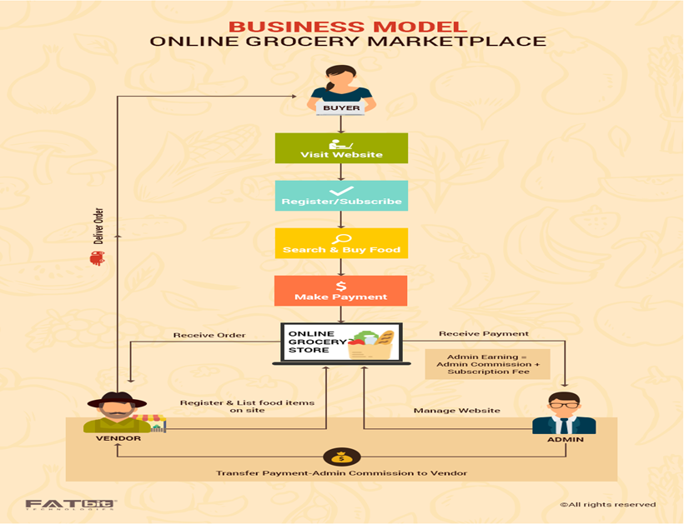
System Architecture
Architecture

Slide 8

Advantages of Proposed System
Reduced processing cost
Improved report generation and analysis
Faster response time
Reduction in man power
Stay organized

Slide 9
Disadvantages of Existing System
User must go to shop and select grocery items
It is time consuming process
Not in reach of distant users
It is less user-friendly

Slide 10
Software Configuration of Proposed System
Operating System : Windows 10
Coding Language : JAVA ,HTML
Data Base : MySQL
Application Server : Apache Tomcat 5.0
IDE : NetBeans 8.1
Devlopment kit : JDK 1.7

Slide 11
Hardware Configuration of Proposed System
Processor : Intel core i5 10thgen
Hard Disk : 40GB
RAM : 4GB
Cache : 512MB

Slide 12
Conclusion
By implementing this grocery management system we are getting the more flexibility for the users
The online grocery shopping Software is made more user friendly to the users, so that anyone can run the software.

Slide 13
THANK YOU

